Slide 1
Challenges faced by ERICs
Antje Keppler
ERIC Forum Chair

Slide 2
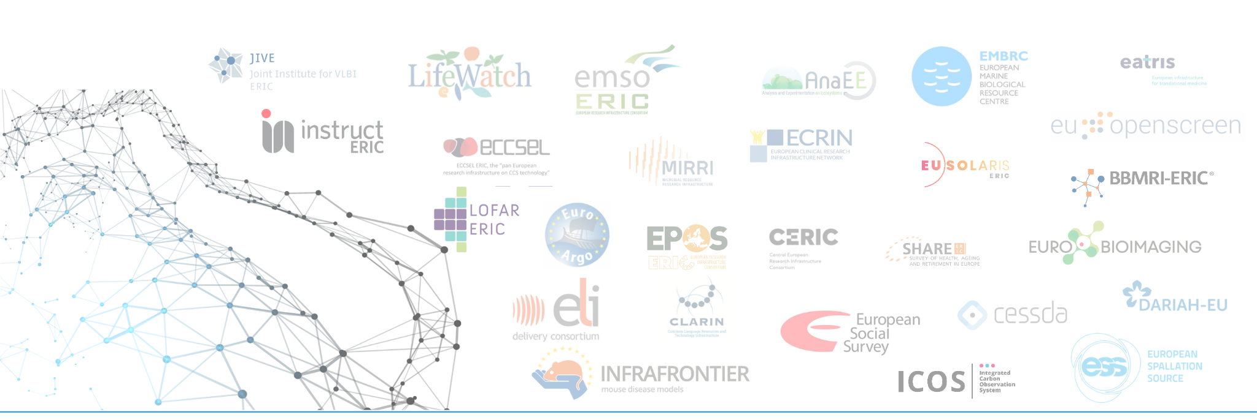
ERIC Forum: who are we?
The bottom-up collaboration of the 28 European Research Infrastructure Consortia (ERIC) since 2017.

Slide 3
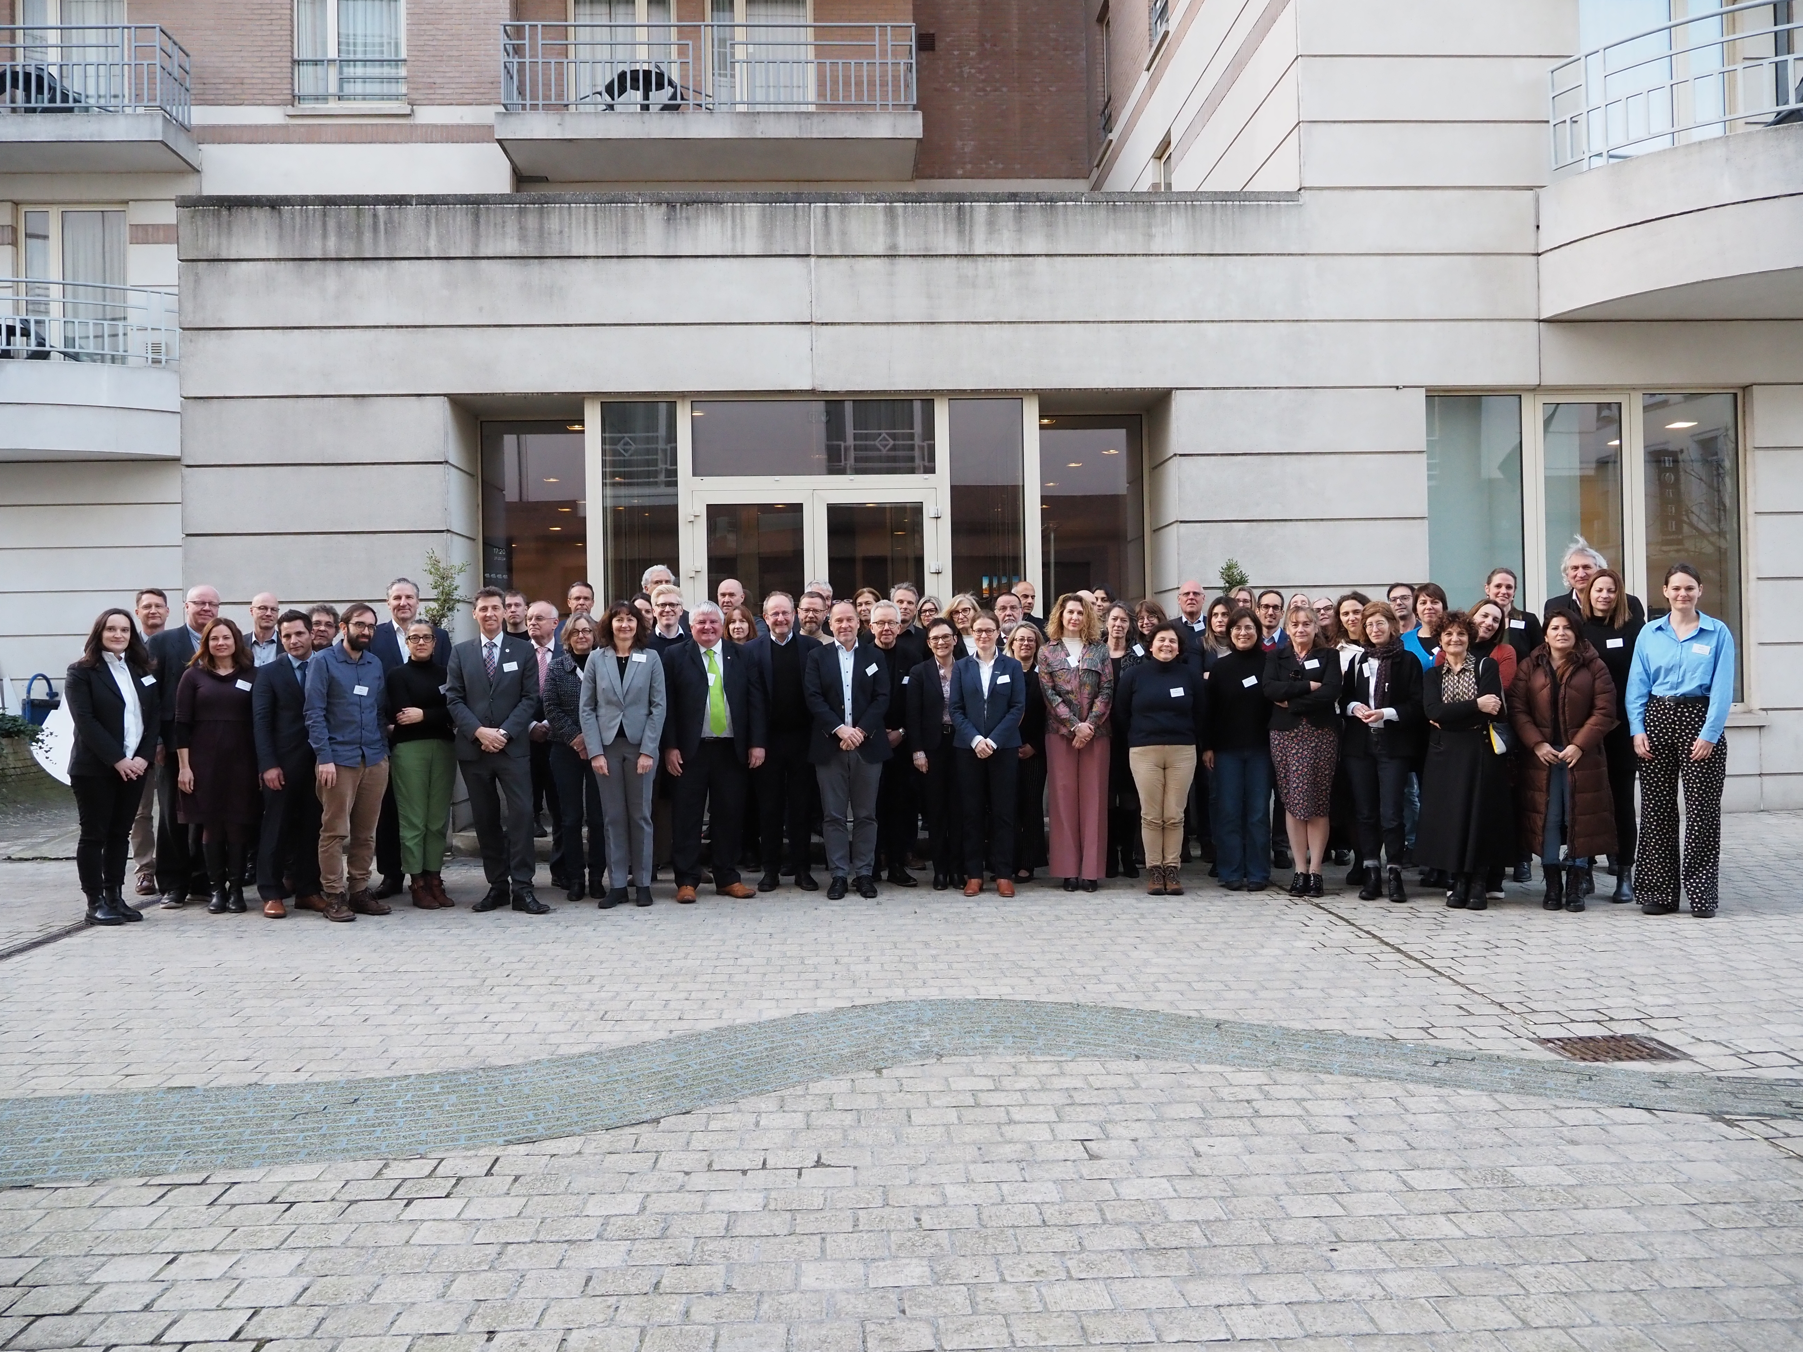
ERIC Forum - Our Mission
Ecosystem of 28 ERICs of cross-domain collaboration, exchange & support:
Sharing best practices and experience
Identifying and tackling common challenges
Fostering visibility, impact and sustainability of ERICs
Being the voice of all ERICs on matters of common interest
Contributing to the European science policies and research context

Slide 4
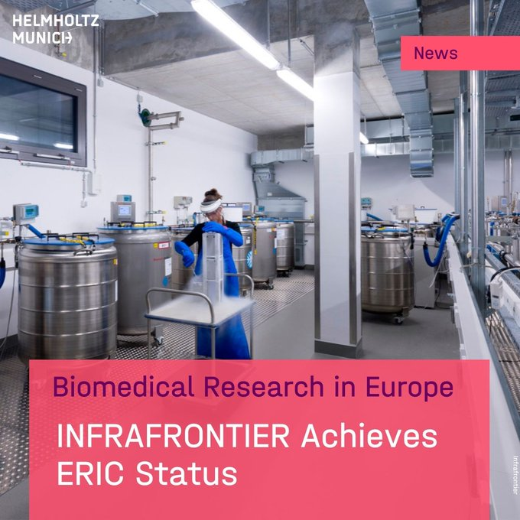
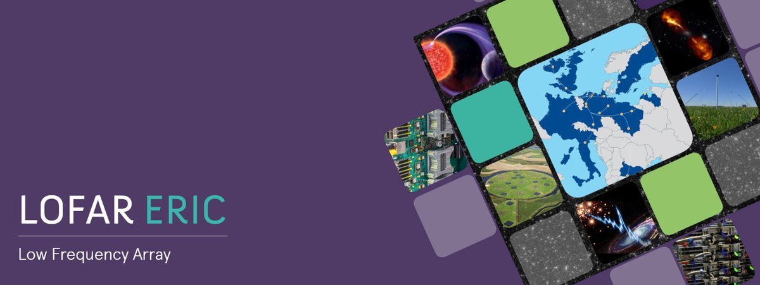
Challenges across ERICS: IMPLEMENTATION
National institutions still need to recognize better and learn more about ERICs as existing legal entities (e.g. eligibility for national funding)
Better guidance on activities of ERICs, also to enhance their broader impact for all stakeholders involved
Strengthen ERICs to become part of a globally integrated RI ecosystem
NEW
NEW

Slide 5
Challenges across ERICS: OPERATION
Funding programs for RI utilization (e.g. user access) are complex, fragmented, & under-resourced => Scientists cannot fully benefit from ERIC services
ERICs need to be included continuously in underpinning wider EU policy objectives (e.g. EU Missions, strategies addressing societal challenges)
Limited economic activity not clearly defined for ERICs causing potential conflicts
Researchers who contribute to RIs need to receive appropriate credit for it.
NEW

Slide 6
Challenges across ERICs: SUSTAINABILITY
Fortifying the capabilities of existing RIs will result in a more sustainable and efficient use of investments and resources
Critical resource limitations and understaffing endanger ERICs in living up to their actual capacities
Lack of career perspectives and diverse employment conditions make it difficult for ERICs to become and remain attractive employers for highly skilled staff and hinder mobility
Need for much better visibility and recognition across all ERIC stakeholders

Slide 7
Strengths of ERICs
ERICs allow for country-level participation which provides for their sustainability.
ERIC is a well tested legal model across EU and associated countries.
Well functioning governance model that is embedded in ERIC Statutes.
Legal reports (e.g. EGERIC Report) provide additional know-how.
A broad community of existing ERICs which underpin European research & strategy.
ERICs combine their primary missions with addressing the big challenges and serving as implementors of EU policy objectives.

Slide 8
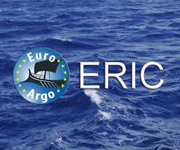
NEW - ERIC Forum Position Paper on FP10
In its latest position paper, the ERIC Forum presents the following considerations for the future EU Framework Programme 10 (2028 - 2034), focusing on
Enhanced Funding Modalities for ERICs
Recognition of the Existing ERICs as Strategic Assets and Resulting Consolidation of the European RI Landscape
Expanding their Geographical Inclusion and Structural Support
Adapting and Enhancing ERIC Governance Models
Strengthening Innovation and Service to Industry
Facilitating Access to ERIC Services by European Researchers

Slide 9
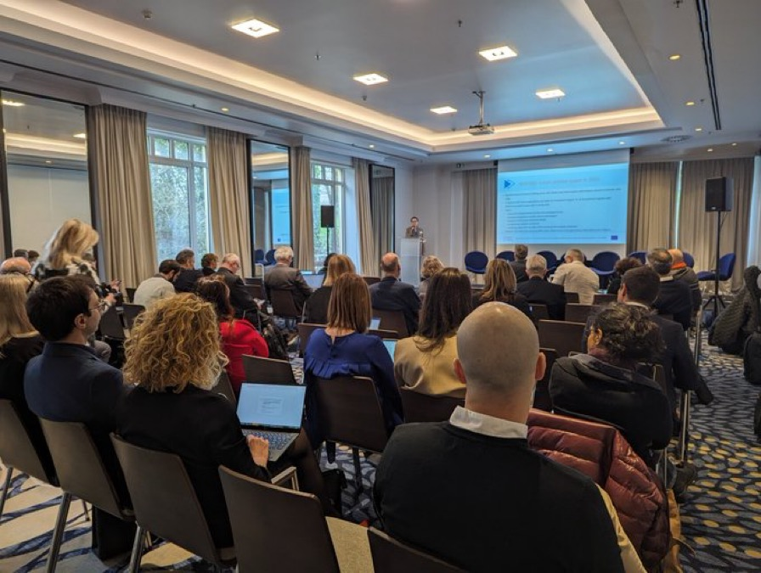
In 2024 ERIC Forum contributes to … (selection)
Strengthening the ERIC ecosystem in the ERIC Forum Project 2
The EOSC Federation as Mandated Organization in the EOSC-Association
A new EC informal Expert Group on Technology Infrastructures
Addressing an update of the ERIC operational guidelines
Drafting an update of the European Charter for Access to RIs
Highlighting RI needs for Framework Program 10
Supporting and providing advice to prospective ERICs for their implementation

Slide 10
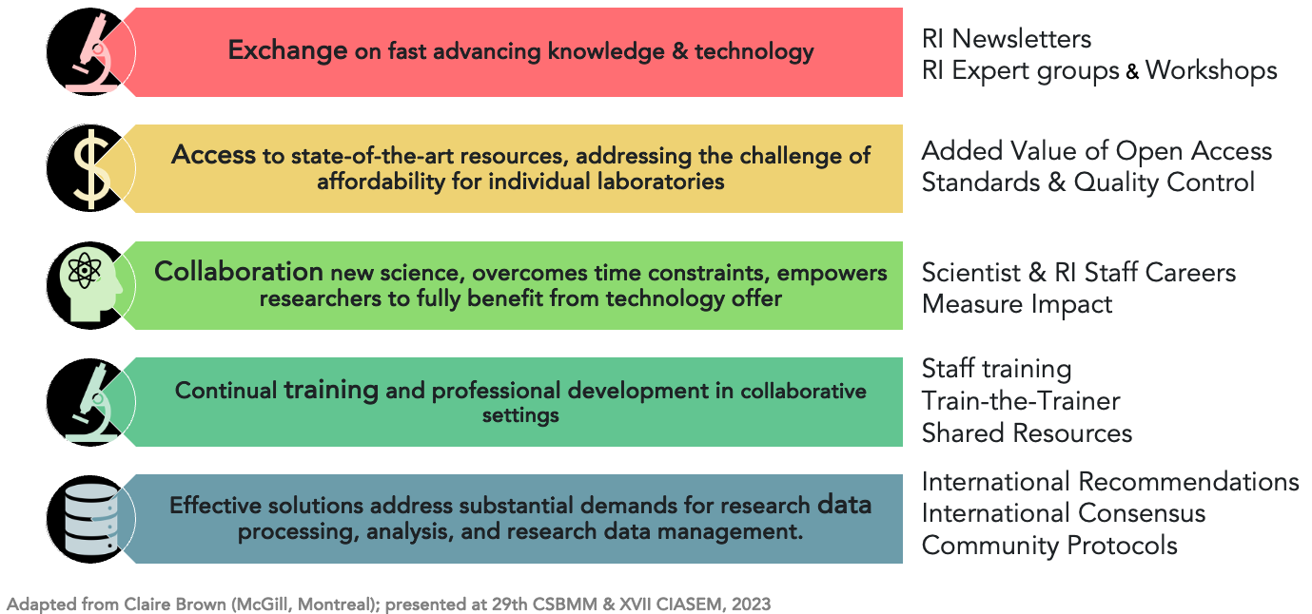
European Research Infrastructures are
Changing the Science Ecosystem

Slide 11
28 operational ERICs are Strategic Assets for the ERA

Slide 12
THE
THANK YOU

